Slide 1
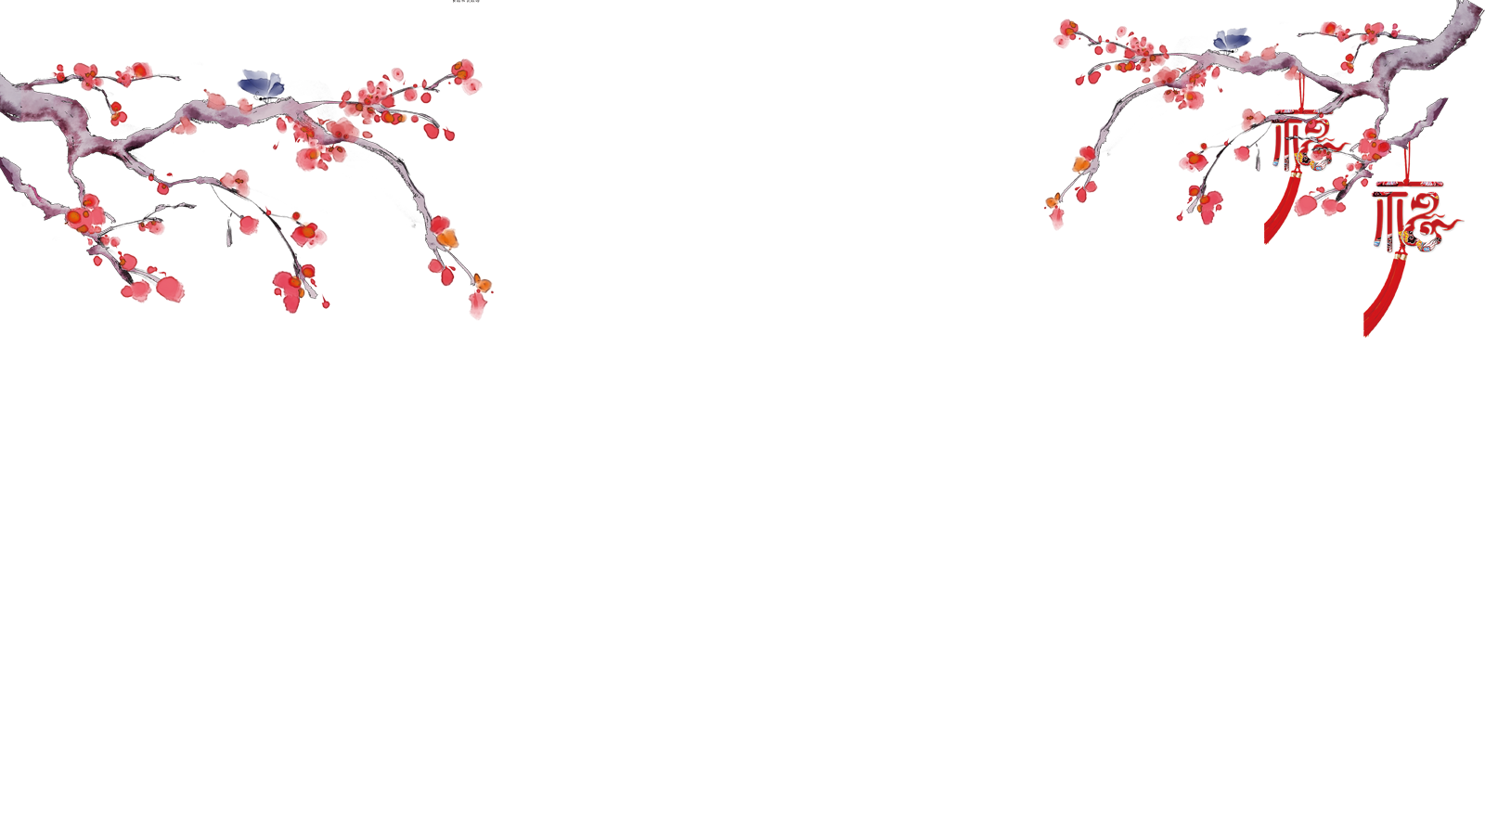
A Special Tableware
—Chopsticks

Slide 2
Guess a riddle
The twin sisters are of the same length,
They always work at the same time;
All kinds of flavor like salty and bitter
are firstly tasted by them.
Chinese people use them every day while eating.
Chopsticks

Slide 3
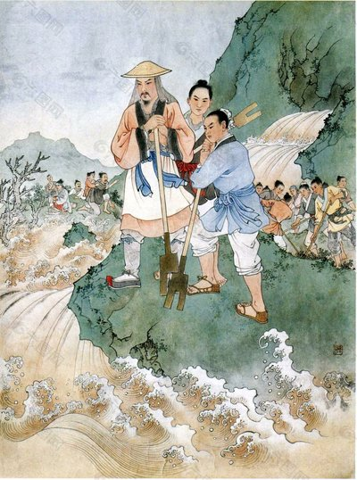
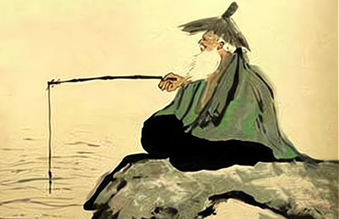
I.The story and development of chopsticks
2. Yu
In order to save enough time to subdue the flood, Yu could not wait to eat hot food in the pot by branch. GraduallyYu ate food with sticks every meal,many people imitated Yu to eat by sticks.
1. Jiang Shang
A bird gave Jiang Shang two magic bamboo sticks which can test if the food is ponsinious .As a result,Jiang Shang ate every meal with sticks and his neighbours follow the example to eat by sticks.

Slide 4
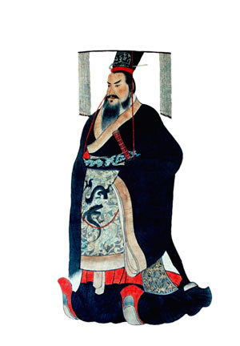
I.The story and development of chopsticks
Early in Xia Dynasty(21st -16th century B.C),the shape of chopsticks was still in development.
Chopsticks only became two sticks of the same length in the Shang Dynasty (16th -11th century B.C.).

Slide 5
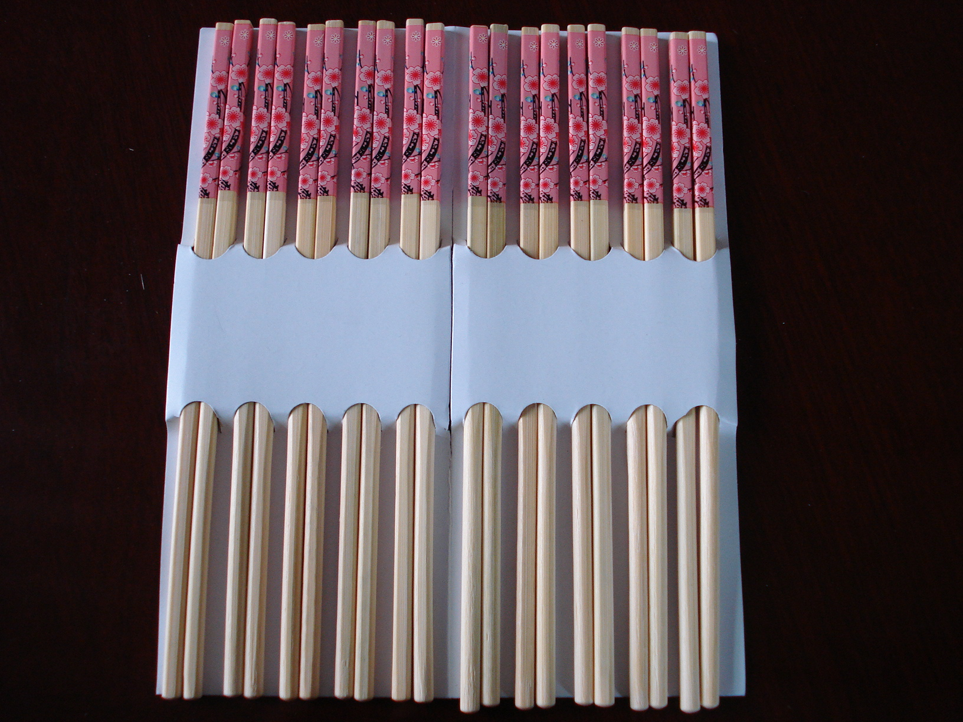
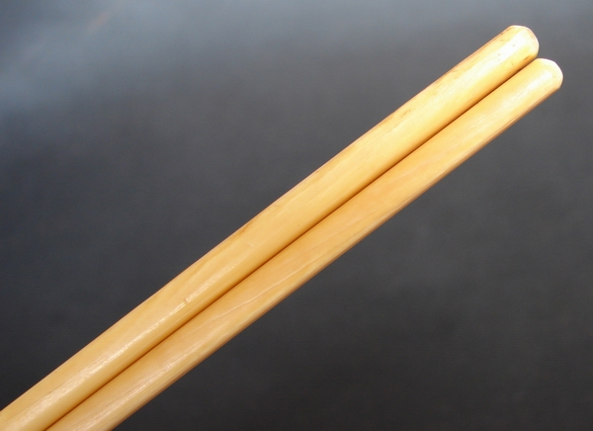
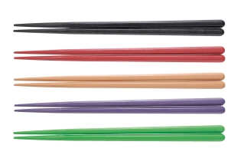
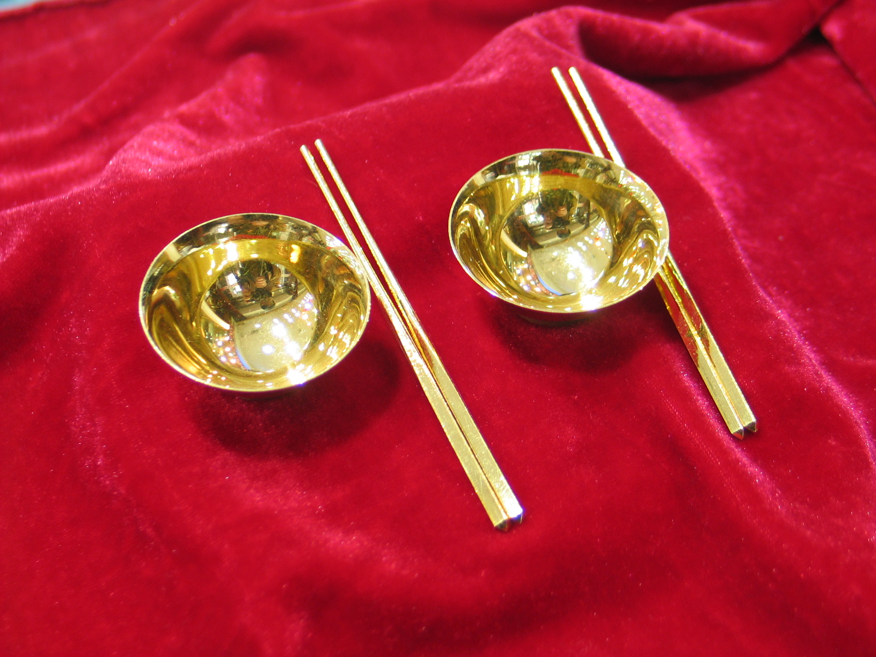
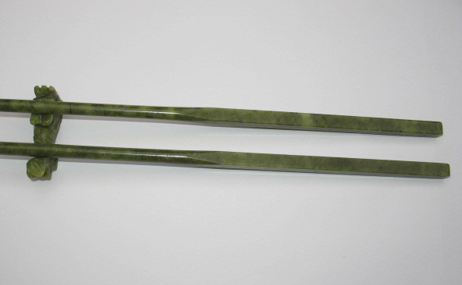
II. Various types of chopsticks
jade chopsticks
plastic chopsticks
ivory chopsticks
gold chopsticks
bamboo chopsticks

Slide 6
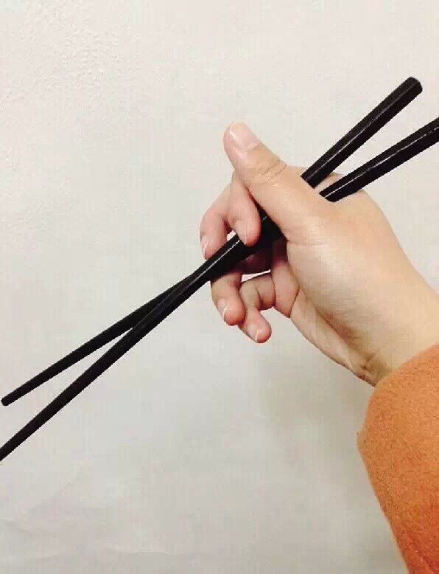
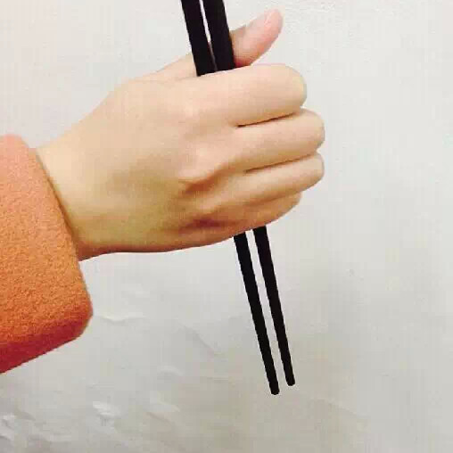
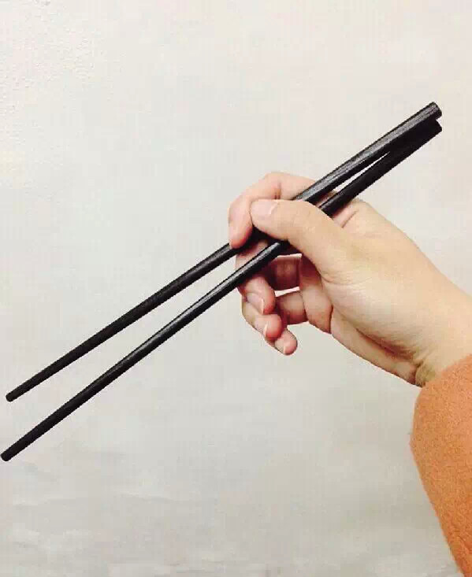
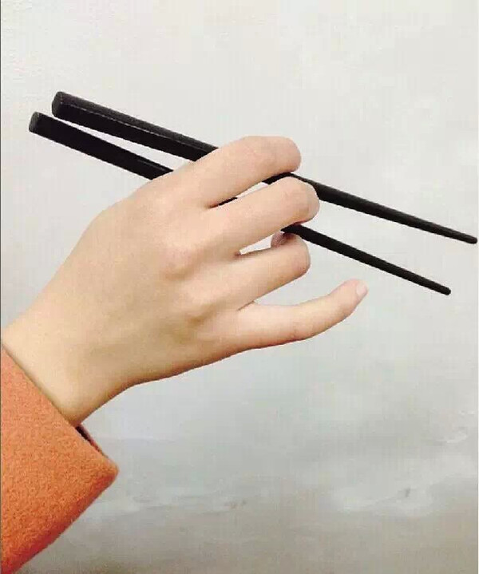
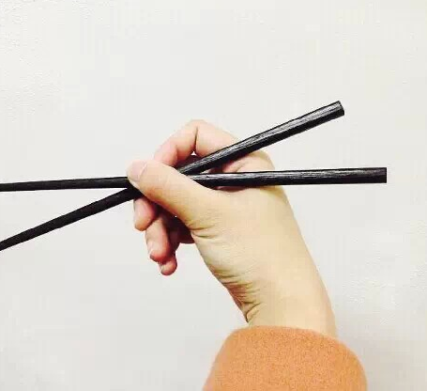
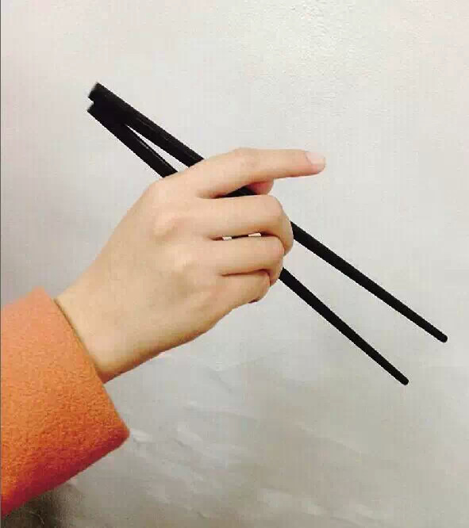
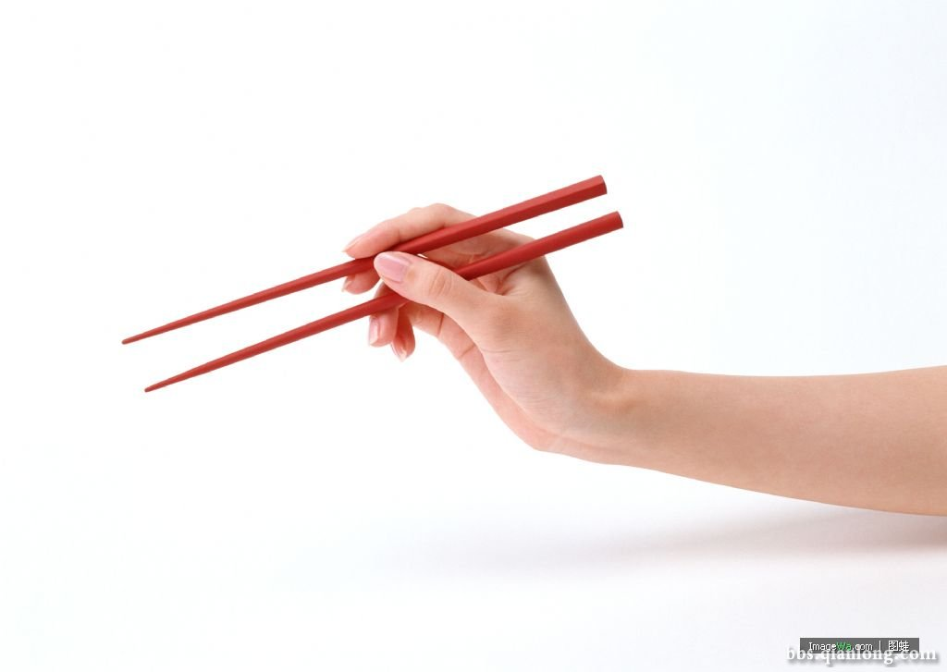
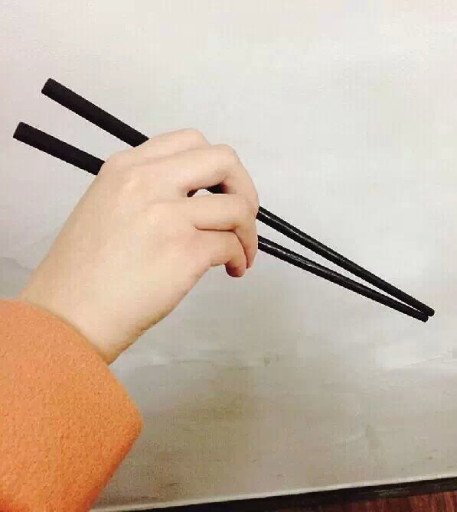
III.How to use chopsticks?

Slide 7
IV.Some table manners about chopsticks
1.Don't stick chopsticks into the food.
2.Don't strech your index finger with chopsticks.
3.It's rude to hit an empty bowl with chopsticks.
4.It's impolite to stur everything in the dish.

Slide 8
V.Conclusion about chopsticks
Chopsticks ,as one of the most famous Chinese cultural symbols, also have a great influence in the world. As we all know, it's a kind of tool that spreads our culture abroad.When it refers to chopsticks,people will firstly think of China. Someone only says: if you can use chopsticks, you are half Chinese. What can we learn from mere chopsticks? Personally, I have used them all my life, but it was only recently I realized the depth of influence they had in many people's way of life.

Slide 9
V.Conclusion about chopsticks
Practice makes perfect.
Using chopsticks doesn't come naturally. You have to learn to use them and practice it. But how will you learn? Should you just read about it? Most would agree that there's no better way to practice than to look at the delicious food in front of you and tell yourself that you can't have any until you can use the chopsticks to get it.

Slide 10
Thank you!

