Slide 1

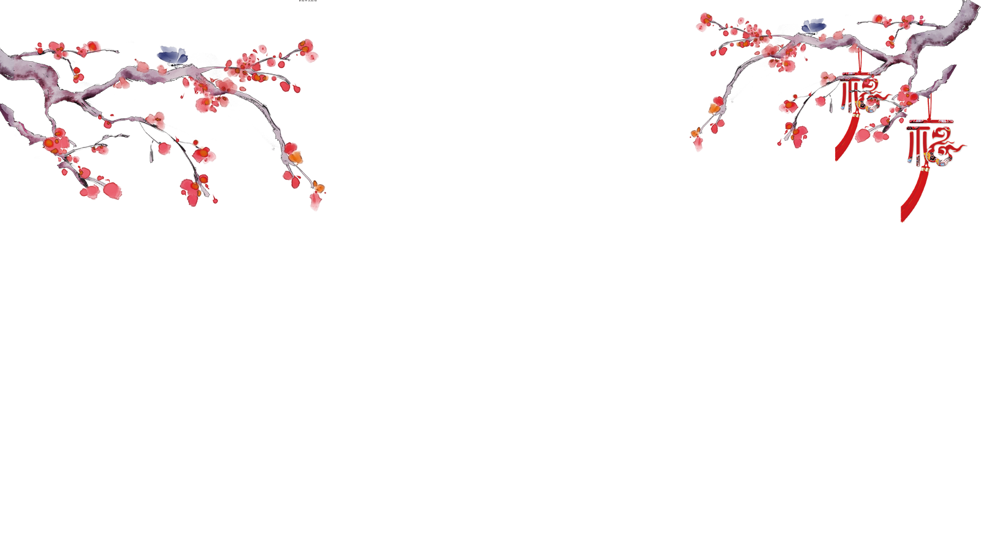

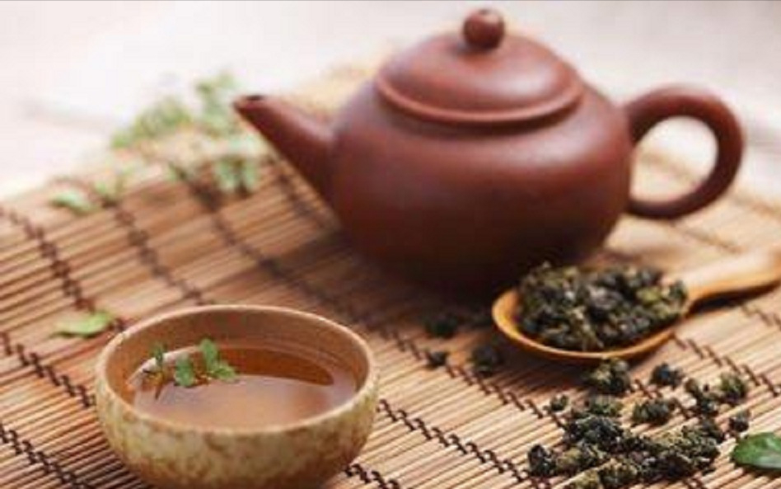
Chinese Tea Culture

Slide 2
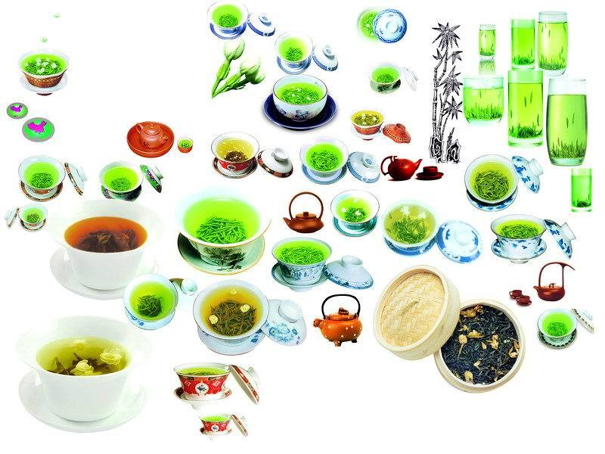
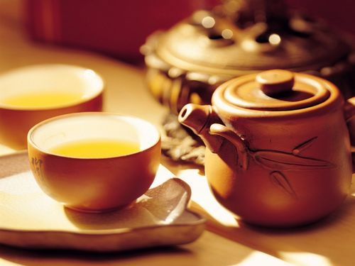
The History and Legend of Chinese Tea
Classification of Tea
Benefits of drinking Tea
Steps of Making Tea
Customs in Drinking Tea

Slide 3
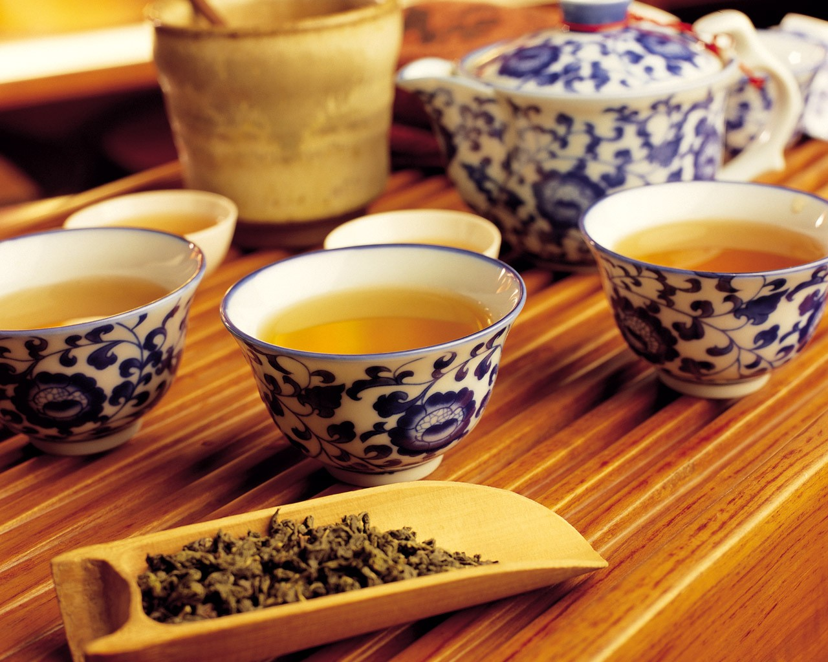
The History of Tea
China is the initial place of tea and also the first country to discover the tea tree and make use of it. Early back to primitive society, tea has been used as medicine. It has been found in the record documents of China’ Zhou dynasty about 1100 BC.
Return

Slide 4
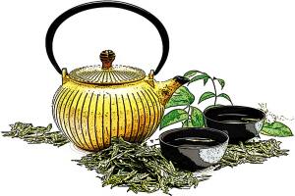
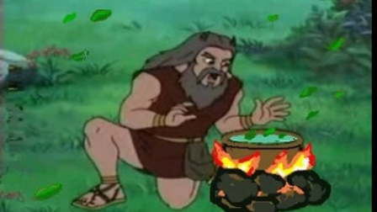
The History of Chinese tea
"Tea as a beverage originated with Shennong." ——The Classic of Tea
“茶为之饮，发乎神农也。” ——《茶经》
According to an Ancient Chinese legend, the emperor Shen Nong discovered tea when he was boiling drinking water over an open fire. Some leaves from a nearby bush fell into the water and remained there for some time. The emperor noticed that the leaves in the water produced a pleasant smell. Later he decided to taste the hot mixture. It was quite delicious. And in this way, one of the world’s favorite drinks was invented.

Slide 5
How many kinds of tea could you tell?
Classification of Tea
Green tea
Black tea
Dark tea
White tea
Oolong tea
Scented tea
Degrees of fermentation
Notes:
Chinese tea can be classified in different ways.In this section,we will introduce the basic classification system of Chinese tea to you,which is based on the degree of fermentation (发酵程度）of the tea.

Slide 6
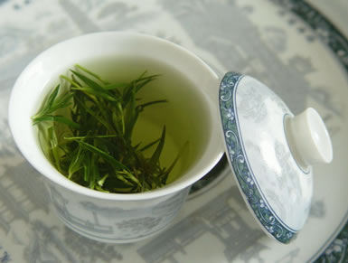
Green Tea
Green tea is one of the most common tea we can see in our daily life. The Chinese have known about the medical benefits of green tea since ancient time, using it to treat everything from headaches to depression.

Slide 7
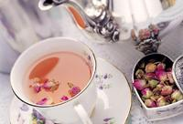
Scented tea
It is made of some flowers like rose and chrysanthemum. When you feel happy, drinking some flower tea, you will feel the pleasant taste always around you.

Slide 8
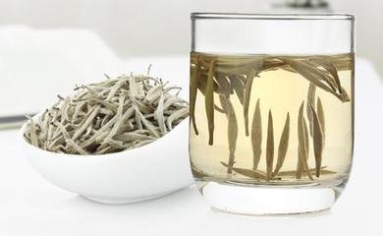
White Tea
White tea belongs to one of the slightly fermented tea. It gets the name from the white bud- leaf （白芽叶）looking like silver color.

Slide 9
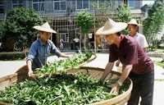
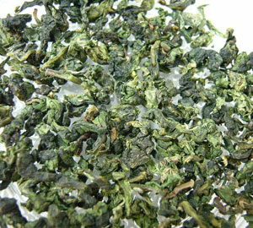
Oolong tea
Oolong ['u:lɒŋ] tea is also called wulong or wu-long tea. They are all the same tea. Oo means Black. Long means Dragon. So the word oolong means Black Dragon. It’s very popular in southestern China.

Slide 10
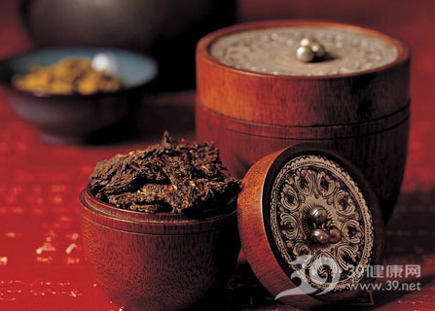
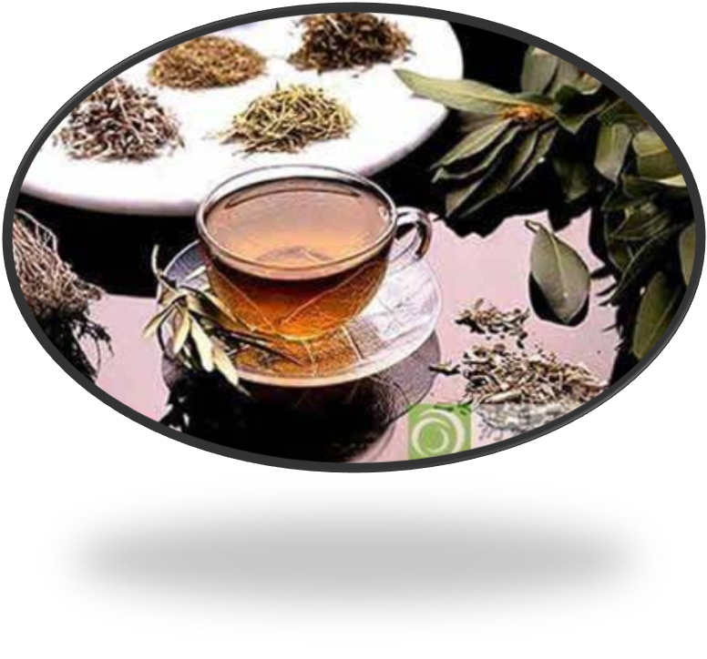
Dark Tea
Dark tea has iron black and enveloped leaves. It is the tea for morning, refreshing ,and sobering up.

Slide 11
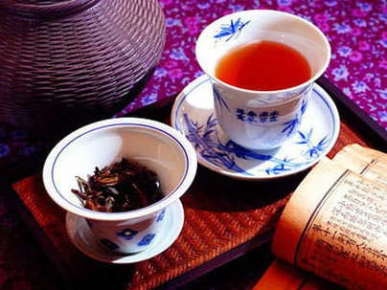
Black Tea
The most essential character of black tea is red tea water, red leaves and sugariness（糖制）[’ʃʊgərɪnɪs]。 The color of dry black tea is red with black, so that “Black Tea” in English means “the black tea”.

Slide 12

Benefits of Drinking Tea
Make people refresh, enhance thinking and memory ability
Eliminate fatigue and help to keep the normal heart, blood vessels
Tea drinking can prevent dental caries
has a good weight loss and beauty effect

Slide 13
let's see how to make Chinese Tea!
Divide tea
分茶

Slide 14
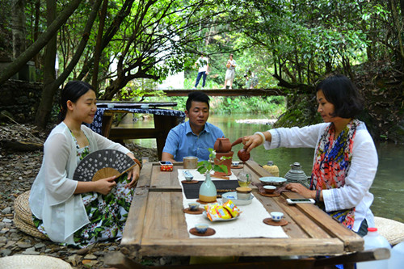

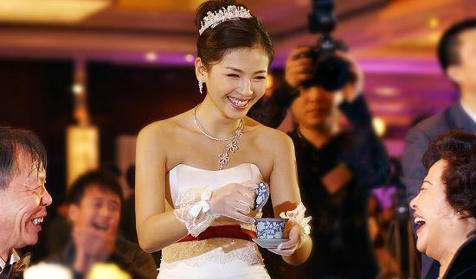
Customs in Drinking Tea
Revival of tea culture
Enjoy tea with friends and families
Business occasions with partners
Breaks during your working hours
In ceremonies like wedding or festivals

Slide 15


